Slide 1
Linear Gaussian models

Slide 2
Last class overview
Modeling the mean and variance of a Gaussian distribution.
Comparison of mean and variances
Priors and Posteriors
Conditional distributions and MCMC
Bayesian inference and frequentist inference.

Slide 3
Today’s class
Gaussian linear model:
VERY brief intro (review) of Gaussian linear models
Regression and classification effects
Priors
Posterior analysis
Comparison to frequentist analysis

Slide 4
Review of linear models

Slide 5
Linear models
Stochastic
Vector of responses
Vector of residuals
(errors)
Error variance
Incidence matrix
Vector of linear parameters
Deterministic
Classification effects with two groups
(no intercept)
Linear regression

Slide 6
Linear models incidence matrices
In regression problems there is one column per predictor. Usually the matrix is full rank (a column is not a linear combination of other columns)
In classification effects models, each factor is represented by a set of columns. Matrix is usually not full rank, but they can be expressed as full rank (reparameterized)

Slide 7
Incidence matrix reparameterization
One factor with 3 levels and 3 observations in each level
Cell mean model (full rank)
Unconstrained (not full rank)

Slide 8
Priors for linear parameters
Typically, a Gaussian prior is used
Even more common are independent priors
Remember: all hyperparameters have to be elicited independently from the data.
Common “non-informative” choices:

Slide 9
Priors for error variance
Typically, a scaled inverse chi-square is used
This is equivalent to an inverse gamma prior
Or to a gamma prior for the inverse of variance

Slide 10
Prior elicitation for variances
The equivalence gives a clue on how to generate priors:
Take a guess at the variance
Weight it assuming an equivalent sample size, then:

Slide 11
Posterior analysis
In many cases the analysis is straightforward, and an analytical solution is possible.
In this class we will focus on posterior analyses of the MCMC chains obtained with stan.

Slide 12
Posterior distribution of parameters and their functions
MCMC chain of linear parameters
Burn-in
Posterior distribution based on these iterations

Slide 13
Prediction of the mean
From an MCMC Chain, the predicted means are very simple to obtain using a linear transformation:
Here the (m x p) Matrix Z contains the points at which the mean will be evaluated and the linear transformation is applied to each draw of b in the Gibbs sampler chain. Then the mean is computed. Notice Z will have m rows corresponding to m points at which the mean will be estimated. The values are sampled from:

Slide 14
Credibility intervals and bands
Credibility bands are also straightforward using the linear transformation:
Instead of computing the mean, we can compute the confidence intervals at each position (row of Z). Joining credible intervals generate the band. Values are sampled from:

Slide 15
Prediction of future observations
If instead of the mean, we want to predict new observations, we need to sample the residual as well:
Needed quantities are samples from
Based on samples of the transformed values, means and credibility intervals for future observations can be produced. We will come back to this with model checking.

Slide 16
Testing hypothesis
Let’s assume a simple linear regression model
How do we test the hypothesis: H₀: β=0? The formal way is to compare the model to a reduced model using a Bayes Factor:

Slide 17
Testing hypothesis
Full model:
Reduced model:
Notice we need to elicit separate priors. This may be tricky.
In fact, we will touch on Bayes Factor in subsequent classes. So I will not explain this today. But let’s see an alternative ways.

Slide 18
(instead of) Testing hypothesis
What is we know that a slope β > c (where c is a known value) represents a critical point in our system?
Instead of testing the hypothesis H₀: β≤0, we can directly estimate the probability: P(β > c )!!!

Slide 19


Testing differences between levels of classificatory predictors Credit: Donald Bates (unpublished)
An alternative is to look at the distribution of the difference of two levels:
Compute this tail area
A very small value shows evidence against the null hypothesis that the two distributions are different.
0
$$p=1−2min\left(\sum_{k=1}^{K}{I\left(d_{i,i^{′}}^{(k)}\right)>0},\sum_{k=1}^{K}{I\left(d_{i,i^{′}}^{(k)}\right)<0} \right)$$

Slide 20
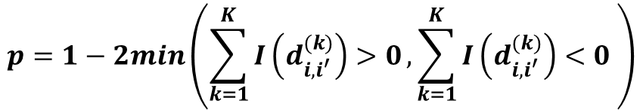
Computing tail area probabilities
Compute this tail area and double it (assume symmetry)
0
0
$$p=1−2min\left(\sum_{k=1}^{K}{I\left(d_{i,i^{′}}^{(k)}\right)>0},\sum_{k=1}^{K}{I\left(d_{i,i^{′}}^{(k)}\right)<0} \right)$$
Note: computation to a single tail can be used if the a direction of change is assumed, similar to a single-tailed test.

Slide 21
Tail area probabilities for multiple levels
Compute tail area probability for each contrast, then see if at least one is small enough to reject hypothesis. This is appropriate for comparing against a reference level.
But using these contrasts, there is a general alternative that is a generalized version of the tail area computation showed before. That computes the joint tail area probability
I will illustrate it here with two dimensions (three levels)

Slide 22
How is this different from frequentist analyses?
It is fundamentally different in the interpretation and in the flexibility (non-linear transformations, relaxing assumptions)
It requires prior distributions, that may affect inferences
It facilitates making probability statements
It makes hypothesis testing more difficult
It may yield numerically similar results
(don’t be disappointed ☺)

Slide 23
Prior and identifiability
Sometimes we use over specified linear models
Incidence matrix for Anova with two groups:
Model is over-specified because matrix X has 3 columns, but first is equal some of the other two. This means that there is no unique solution to the system of equations implied by the model

Slide 24
Frequentist solutions:
Reparametrize model to full rank
2) Keep model but compute only estimable contrasts
For multi-factorial models including interactions, this issue may be more delicate and finding a good model reparameterization or checking contrast estimability is very important.
For more details, refer to class material of ANS 814

Slide 25
Bayesian solutions
In theory, every parameter should be estimable under a Bayesian model because a (proper) prior makes them identifiable. But…
If we compute a “non-estimable” contrast, the prior will have great influence.
If we use an almost non-informative prior. Some contrast will be “almost non-estimable”

Slide 26
Bayesian solutions
For these reasons, we will tend to reparametrize the model to full rank. OR…
Make sure we are computing an estimable contrast (in the frequentist sense).
We will only check convergence of estimable contrast (freq. sense)
We will talk about these models in the model comparison lesson.

Slide 27

An example: regression analysis
Dugongs, original data from Ratkowsky 1986. Included in WinBUGS examples (provided to you).
N=27 samples

Slide 28
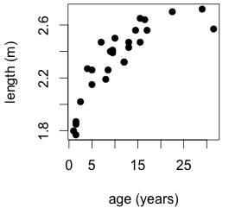
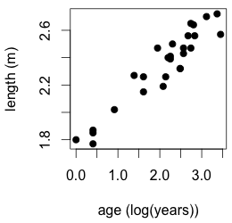
An example
Log-linear relationship
Later we may come back at this problem and fit a non linear model

Slide 29
An example: dugongs
Log-linear relationship
Vector of parameters:
Priors:

Slide 30
priors

Slide 31
Predicting future observations
Suppose we are interested in predicting length of animals at 10 years of age.
average length of all 10 y.o. animals
length of a (random) 10 y.o animal

